Slide 1
CS 4310: Software Engineering
Lecture 2
Developing Requirements

Slide 2
Domain Analysis
The process by which a software engineer learns about the domain to better understand the problem:
  The domain is the general field of business or technology in which the clients will use the software
  A domain expert is a person who has a deep knowledge of the domain

Slide 3
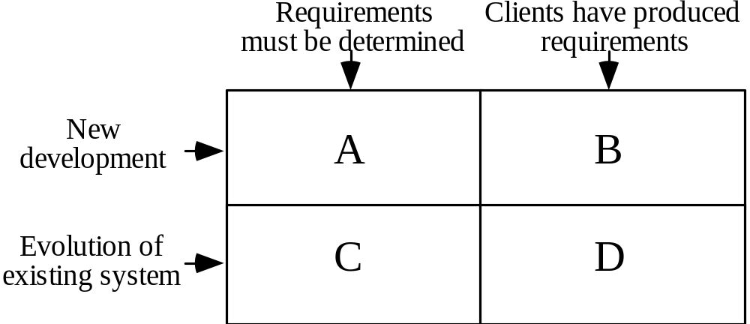
The Starting Point for Software Projects

Slide 4
Defining the Problem and the Scope
A problem can be expressed as:
  A difficulty the users or customers are facing,
  Or as an opportunity that will result in some benefit such as improved productivity or sales.
The solution to the problem normally will entail developing software

Slide 5
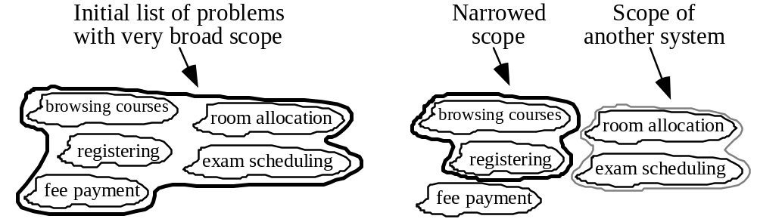
Defining the Scope
Narrow the scope by defining a more precise problem
  List all the things you might imagine the system doing
    Exclude some of these things if too broad
    Determine high-level goals if too narrow
Example: A university registration system

Slide 6
What is a Requirement
Requirement: A statement about the proposed system that all stakeholders agree must be made true in order for the customer’s problem to be adequately solved.
  Short and concise piece of information
  Says something about the system
  All the stakeholders have agreed that it is valid
  It helps solve the customer’s problem
A collection of requirements is a requirements document.

Slide 7
Types of Requirements
Functional requirements
  Describe what the system should do
Non-functional requirements
  Constraints that must be adhered to during development

Slide 8
Functional requirements
  What inputs the system should accept
  What outputs the system should produce
  What data the system should store that other systems might use
  What computations the system should perform
  The timing and synchronization of the above

Slide 9
Non-functional requirements
Three main types
  1. Categories reflecting: usability, efficiency, reliability, maintainability and reusability
    Response time
    Throughput
    Resource usage
    Reliability
    Availability
    Recovery from failure
    Allowances for maintainability and enhancement

Slide 10
Non-functional requirements
  2. Categories constraining the environment and technology of the system.
    Platform
    Technology to be used
  3. Categories constraining the project plan and development methods
    Development process (methodology) to be used
    Cost and delivery date
      Often put in contract or project plan instead

Slide 11
Non-Functional Requirements
Product requirements
performance, reliability, portability, etc...
Organizational requirements
delivery, training, standards, etc...
External requirements
legal, interoperability, etc...

Slide 12
Examples of Non-Functional Requirements
Privacy
Functional requirement:
Usage data for management of system
Non-functional requirement:
Usage data must not identify individuals
Minimizing records
Functional requirement:
Retain all required records
Non-functional requirement:
Discard all other records

Slide 13
Some Techniques for Gathering and Analysing Requirements
Observation
  Read documents and discuss requirements with users
  Shadowing important potential users as they do their work
    ask the user to explain everything he or she is doing
  Session video tapping
Interviewing
  Conduct a series of interviews
    Ask about specific details
    Ask about the stake holder’s vision for the future
    Ask if they have alternative ideas
    Ask for other sources of information
    Ask them to draw diagrams

Slide 14
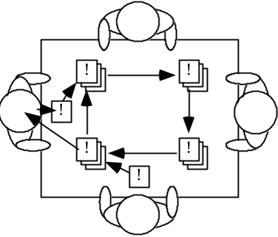
Gathering and Analysing Requirements...
Brainstorming
  Appoint an experienced moderator
  Arrange the attendees around a table
  Decide on a ‘trigger question’
  Ask each participant to write an answer and pass the paper to another person
Joint Application Development (JAD) is a technique based on intensive brainstorming sessions

Slide 15
Gathering and Analysing Requirements...
Prototyping
  The simplest kind: paper prototype.
    a set of pictures of the system that are shown to users in sequence to explain what would happen
  The most common: a mock-up of the system’s UI
    Written in a rapid prototyping language
    Does not normally perform any computations, access any databases or interact with any other systems
    May prototype a particular aspect of the system

Slide 16
Gathering and Analysing Requirements...
Informal use case analysis
  Determine the classes of users that will use the facilities of this system (actors)
  Determine the tasks that each actor will need to do with the system
More on use cases later in the course

Slide 17
Types of Requirements Document
  Two extremes:
    An informal outline of the requirements using a few paragraphs or simple diagrams
      requirements definition
    A long list of specifications that contain thousands of pages of intricate detail
      requirements specification

Slide 18
Level of detail required in a requirements document
  How much detail should be provided depends on:
    The size of the system
    The need to interface to other systems
    The readership
    The stage in requirements gathering
    The level of experience with the domain and the technology
    The cost that would be incurred if the requirements were faulty

Slide 19
Reviewing Requirements
  Each individual requirement should
    Have benefits that outweigh the costs of development
    Be important for the solution of the current problem
    Be expressed using a clear and consistent notation
    Be unambiguous
    Be logically consistent
    Lead to a system of sufficient quality
    Be realistic with available resources
    Be verifiable
    Be uniquely identifiable
    Does not over-constrain the design of the system

Slide 20
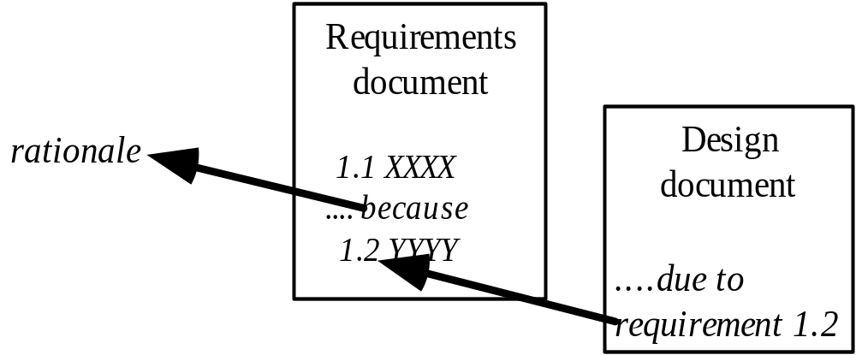
Requirements documents...
  The document should be:
    sufficiently complete
    well organized
    clear
    agreed to by all the stakeholders
  Traceability:

Slide 21
Requirements document...
  A. Problem
  B. Background information
  C. Environment and system models
  D. Functional Requirements
  E. Non-functional requirements

Slide 22
Managing Changing Requirements
Requirements change because:
  Business process or Technology changes
  The problem becomes better understood
Requirements analysis never stops
  Continue to interact with the clients and users
  The benefits of changes must outweigh the costs.
    Certain small changes (e.g. look and feel of the UI) are usually quick and easy to make at relatively little cost.
    Larger-scale changes have to be carefully assessed
      Forcing unexpected changes into a partially built system will probably result in a poor design and late delivery
  Some changes are enhancements in disguise
    Avoid making the system bigger, only make it better

Slide 23
Difficulties and Risks in Domain and Requirements Analysis
  Lack of understanding of the domain or the real problem
    Do domain analysis and prototyping
  Requirements change rapidly
    Perform incremental development, build flexibility into the design, do regular reviews
  Attempting to do too much
    Document the problem boundaries at an early stage, carefully estimate the time
  It may be hard to reconcile conflicting sets of requirements
    Brainstorming, JAD sessions, competing prototypes
  It is hard to state requirements precisely
    Break requirements down into simple sentences and review them carefully, look for potential ambiguity, make early prototypes

Slide 24
The Requirements Process
Feasibility
Study
Requirements
Analysis
Requirements
Definition
Feasibility
Report
Requirements
Specification
System
Models
Definition of
Requirements
Requirements
Document
Specification of
Requirements

Slide 25
Requirements Specification
What is the purpose of the Requirements Specification?

Slide 26
Requirements Specification: Purpose
1. It describes the requirements to the stakeholders
• Expressed in the terms that the stakeholders understand
• Comprehensible from many viewpoints
• Reviewed by stakeholders so that they understand implications
• Must be clear about assumptions (things left out)

Slide 27
Requirements Specification: Purpose
2. It describes the requirements to the implementers
• As precise and specific as possible
• Expressed in terms that they understand
• Comprehensible to new team members

Slide 28
Requirements Specification: Purpose
3. It records the requirements for the future
• An essential part of system evolution
4. If may be a contractual document
• See you in court!

Slide 29
Your Project Work
Scope your project topic and requirements.
Begin formulating a list of requirements.

